Slide 1
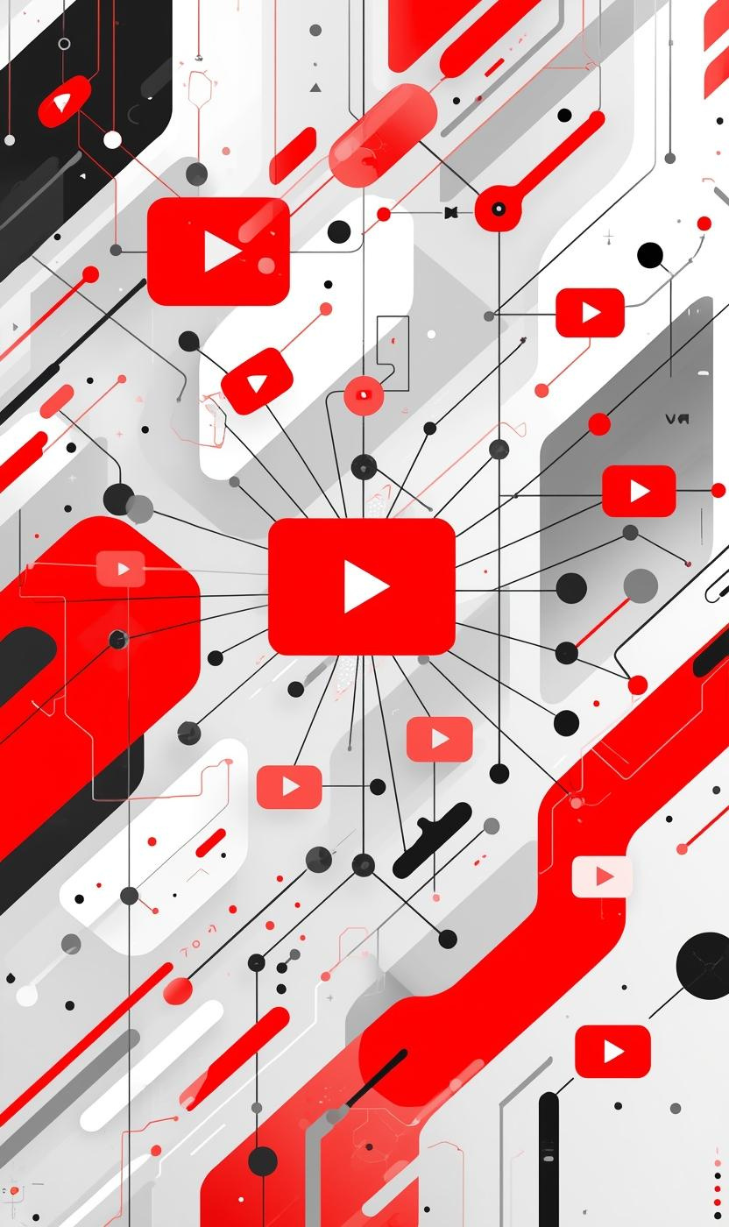

YouTube - BPMN Diagram
Module: Recommendation and Personalization System
GROUP-6
PRESENTED BY: 2105032
NAWRIZ AHMED TURJO
TEAM MEMBERS: 2105032, 2105033, 2105043, 2105048, 2105049, 2105055
1

Slide 2

Key System Overview
UNIFIED FEED GENERATION & CONTENT DISCOVERY
WATCH HISTORY ANALYSIS & BEHAVIOR TRACKING
1
2
Adaptive feed that merges personal interests, subscriptions, and trending content.
Monitors and learns from watch patterns to refine future recommendations.
USER PREFERENCE & PERSONALIZATION CONTROL
NOTIFICATION SYSTEM
3
4
Gives users tools to customize, reset, or filter their recommendation experience.
Timely, relevant alerts for subscriptions and trending content.
2

Slide 3
POOLs Overview
CLIENT APPLICATION
AI ENGINE
1
2
Maps the Application Interface of YouTube and How it interacts with other key components for the recommendations
Suggestion of videos based on user’s profile and history, uses personalized ranking system powered by AI
DATA SERVICES
NOTIFICATION &
FEEDBACK SYSTEM
3
4
Core Engine which handles all Database interaction
Provides personalized notifications and receives feedback from users
USER CONTROL CENTER
5
Handles the settings and paternal controls
3

Slide 4
POOL : Client application
1
OVERVIEW
FEED DISPLAY MANAGER
FEED LOADING AND REFRESH CYCLES
PERSONALIZED FEED REQUESTS
FEED RESPONSE WAITING STATE
WITH AI ENGINE FOR CONTENT DELIVERY
UI RENDERING
VISUAL INTERFACE DISPLAY
ONBOARDING VS USER EXPERIENCE
RENDERS HOME FEED, VIDEO PLAYER, AND SETTINGS
APP CACHE FOR SESSION PERSISTENCE
INTERACTION HANDLER
PROCESSES ALL USER INTERACTIONS
SENDS WATCH START DATA TO DATA SERVICES
DYNAMIC LOADING
HANDLES PREFERENCE CHANGES AND FEEDBACK
4

Slide 5
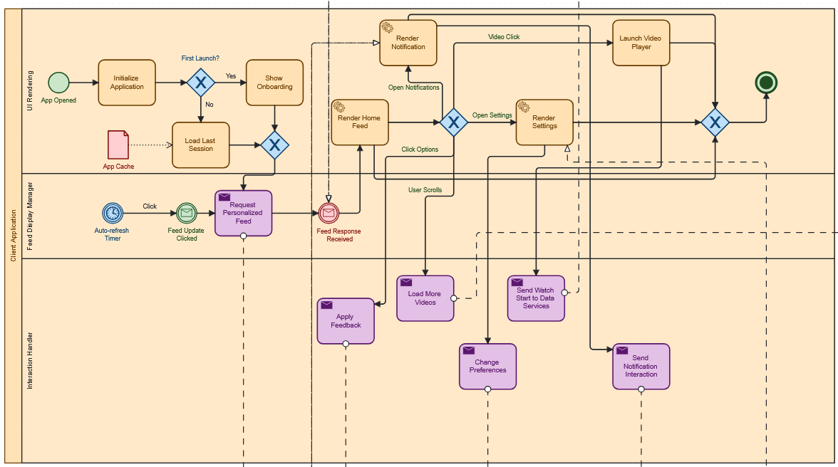
5

Slide 6
POOL : AI Engine
2
OVERVIEW
USER MODELING
GETS USER CONTEXT AND PROFILE DATA
RETRIEVES USER HISTORY FOR PERSONALIZATION
DETERMINES IF SUFFICIENT USER DATA EXISTS FOR PERSONALIZED RANKING
CONTENT ANALYZER
FETCHES TRENDING CONTENT FROM DATA SERVICES
GENERATES CANDIDATE VIDEOS FOR RECOMMENDATION
HANDLES DATA UNAVAILABILITY WITH FALLBACK STRATEGIES
RANKING & BLENDING
COLD-START STRATEGY AND PERSONALIZED RANKING
USES DIVERSITY ALGORITHM TO PREVENT FILTER BUBBLES
BALANCES FEED COMPOSITION (SUBSCRIPTIONS, TRENDING, DISCOVERIES)
6

Slide 7
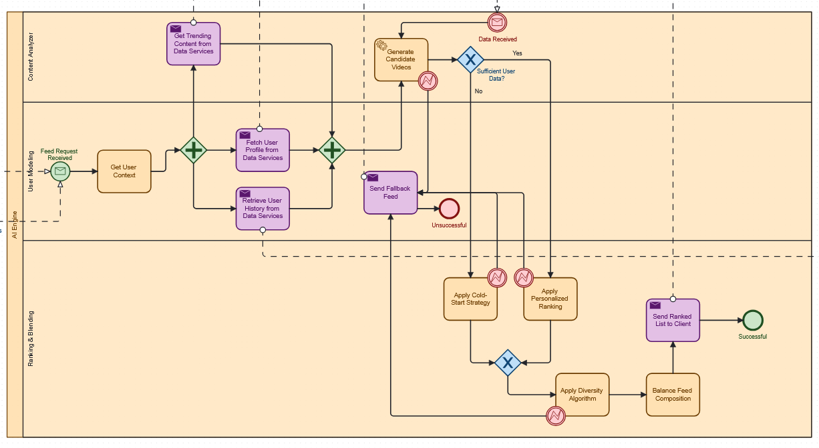
7

Slide 8
POOL : Data Services
3
OVERVIEW
USER DATA STORE
PROCESSES USER PROFILE REQUESTS (GET/POST/PATCH)
MANAGES USER PROFILE DATABASE
CONTENT CATALOG
MANAGES VIDEO CATALOG DATABASE
UPDATES TRENDING SCORES EVERY 5 MINUTES
TRIGGERS NEW CONTENT ALERTS
NOTIFICATION PREFERENCE
MANAGES USER NOTIFICATION SETTINGS
SYNCS SETTINGS ACROSS THE SYSTEM
HANDLES PREFERENCE REQUESTS AND UPDATES
HISTORY RETRIEVAL
QUERIES USER HISTORY DATABASE
MAINTAINS HISTORICAL VIEWING DATA
8

Slide 9
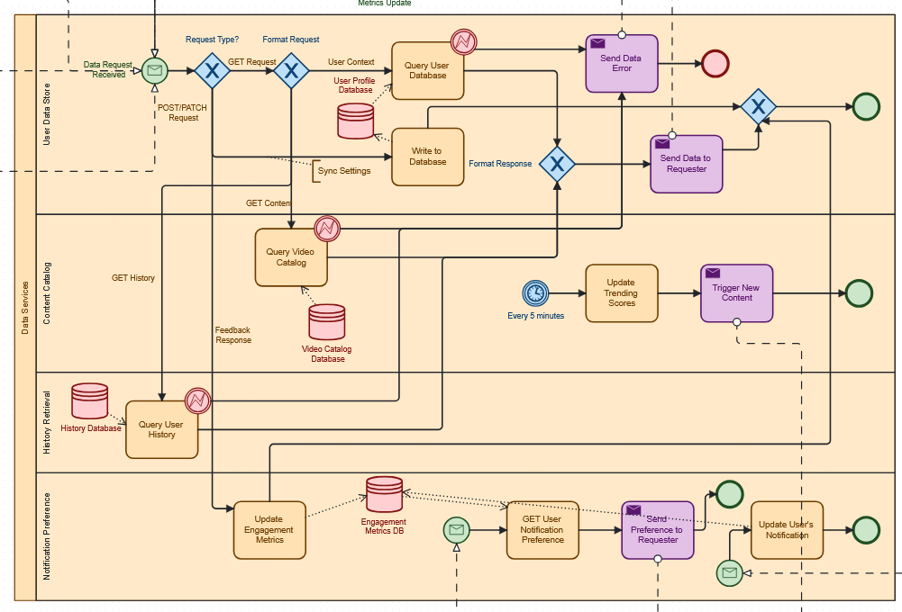
9

Slide 10
POOL : Notification & Feedback System
4
OVERVIEW
NOTIFICATION MANAGER
NEW CONTENT TRIGGER
PERSONALIZES AND SCHEDULES NOTIFICATION DELIVERY
HANDLES NOTIFICATION UPDATES FOR FUTURE REFERENCE
FEEDBACK COLLECTOR
CAPTURES THREE TYPES OF USER FEEDBACK
ROUTES ALL FEEDBACK TO DATA SERVICES FOR SYSTEM LEARNING
PROCESSES USER INTERACTIONS WITH CONTENT
EVALUATION ENGINE
RUNS DAILY ANALYTICS AUTOMATICALLY
PERFORMANCE REPORTS ON RECOMMENDATION EFFECTIVENESS
SENDS METRICS TO DATA SERVICES FOR CONTINUOUS IMPROVEMENT
10

Slide 11
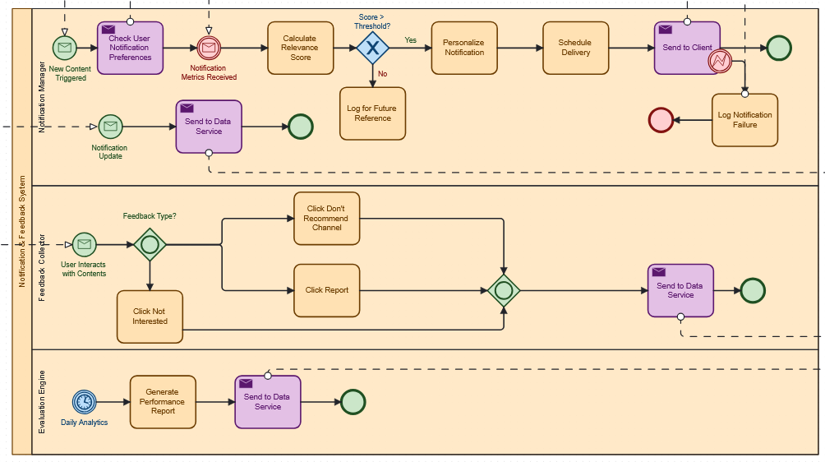
11

Slide 12
POOL : User Control Center
5
OVERVIEW
PREFERENCE MANAGEMENT
AUTHENTICATES USERS BEFORE CHANGES
HANDLES PREFERENCE VECTOR UPDATES
MANAGES PRIVACY SETTINGS MODIFICATIONS
SYNCS SETTINGS TO DATA SERVICES
SENDS CONFIRMATION TO CLIENT AFTER CHANGES
PARENTAL CONTROLS
APPLIES CONTENT RESTRICTIONS FOR YOUNGER USERS
MANAGES AGE-APPROPRIATE CONTENT FILTERING
HISTORY MANAGEMENT
MODIFIES HISTORY SETTINGS (PAUSE/RESUME)
CONTROLS HOW WATCH HISTORY INFLUENCES RECOMMENDATIONS
12

Slide 13
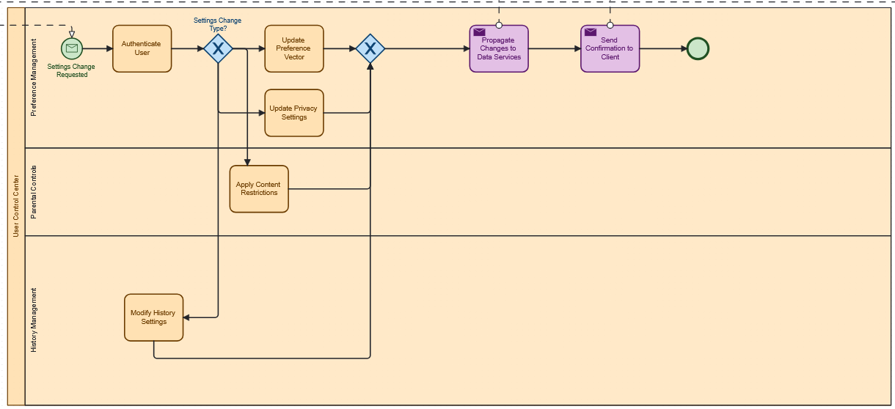
13

Slide 14
thank you
Team Members
NAWRIZ AHMED TURJO (2105032)
SHAMS HOSSAIN SIMANTO (2105048)
ABHISHEK ROY (2105033)
AMIT SAHA (2105049)
MONJUR HOSSAIN KHAN SHOVON (2105043)
ABRAR JAHIN (2105055)
WE WELCOME YOUR FEEDBACK AND SUGGESTIONS!
14

